Slide 1
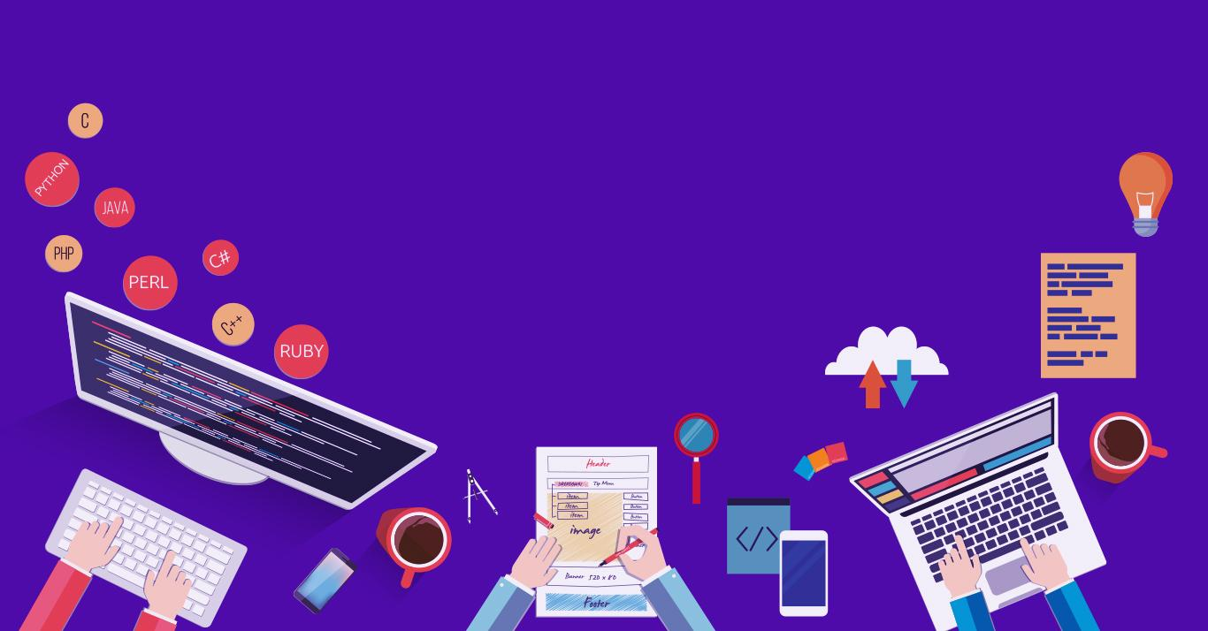

Professional Readiness for Innovation, Employability and Entrepreneurship
GOVERNMENT SCHEMES CHATBOT
210701006 – Aathmihan S B
210701024 – Akshithaa B K
Dr.T.Kumaragurubaran
Computer Science and Engineering Department - REC

Slide 2
Abstract
This project presents a chatbot designed to assist people in Tamil Nadu with information on government schemes. Utilizing the PyTorch library, the chatbot is powered by neural networks featuring a feedforward layer architecture. The system is optimized to deliver accurate, timely recommendations tailored to the user's specific eligibility and needs. By leveraging natural language processing and machine learning techniques, the chatbot can understand user queries and provide personalized guidance. The primary objective is to bridge the information gap, ensuring that underserved communities have easy access to vital resources and opportunities provided by the government.

Slide 3
Existing System
The existing system for recommending government schemes often include various web-based platforms and mobile applications designed to disseminate information about government benefits and services.
Some of the examples include Government portals like TNeGA, Mobile applications like UMANG, Helpline centers like e-sevai maiyam and some NGO initiatives are also taken.

Slide 4
Proposed System
The existing systems may face challenge like limited reach in rural areas.
The proposed chatbot aims to address the gap by providing a user-friendly, accessible platform that uses advanced AI and machine learning techniques.
The key components and functionalities of the proposed system include User Interaction, Neural Network Architecture, NLP, Scheme Database, Personalized Recommendations.

Slide 5
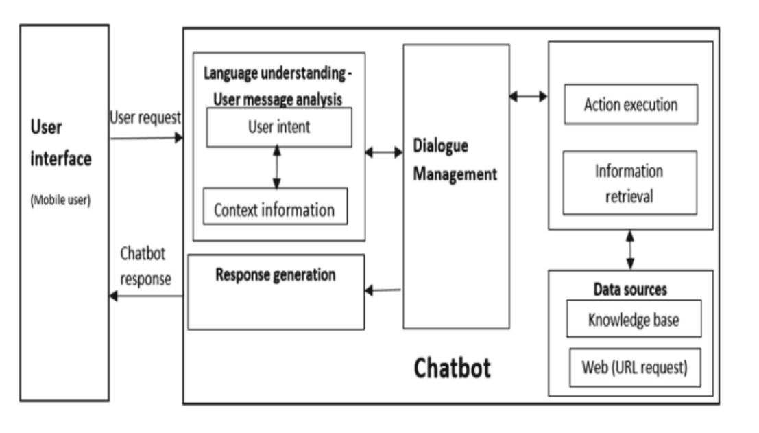
Architecture Diagram

Slide 6
Project Modules
Training Module :
The training module teaches the chatbot to understand and respond to questions. First, it collects data about Tamil Nadu government schemes and user queries. This data is cleaned and prepared for training. Using PyTorch, a feedforward neural network is set up with input, hidden, and output layers. The model learns by comparing its answers to correct ones and adjusting until it improves. It is then tested with new data to ensure accuracy.

Slide 7
Project Modules
Chat Module :
The chat module is where users interact with the chatbot. It captures user queries through text inputs and processes them. The trained neural network understands the questions and generates relevant answers by retrieving information from a database of government schemes. It personalizes responses based on the user's background and previous interactions. This module ensures users get accurate, easy-to-understand guidance on government schemes.

Slide 8
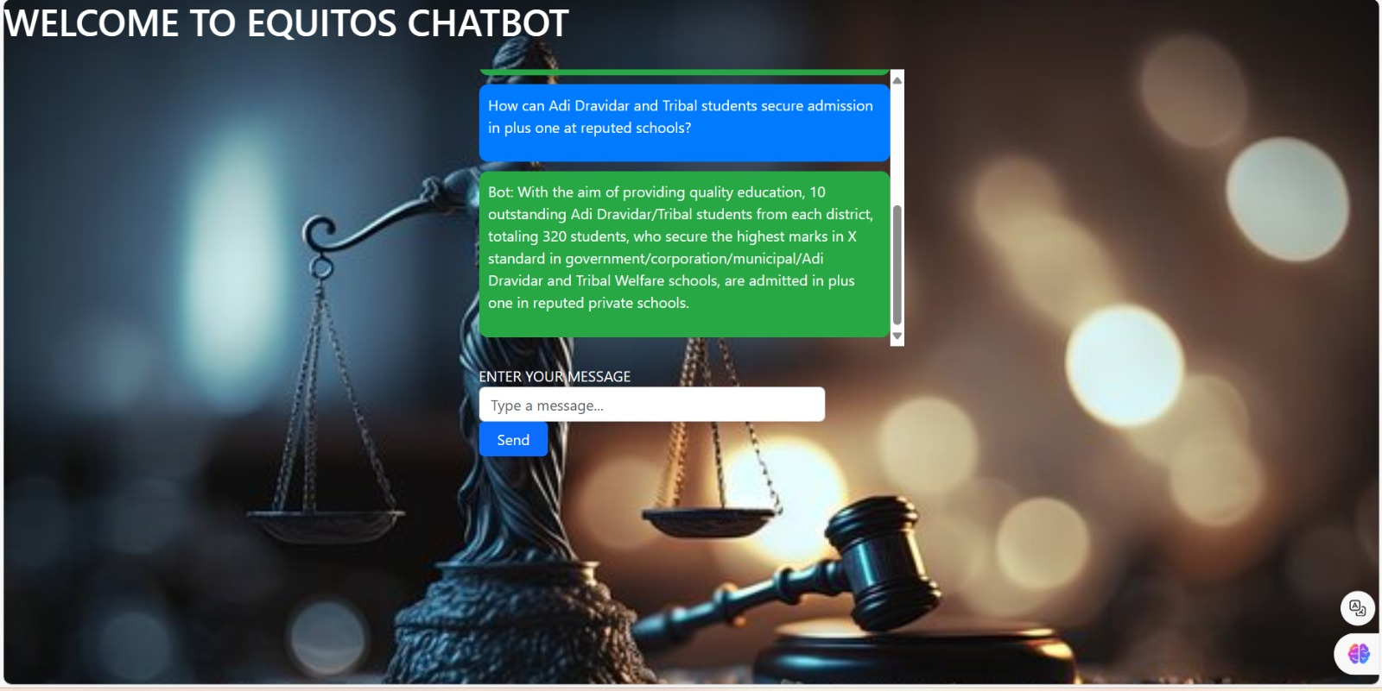
Output

Slide 9
Future Enhancements
Our chatbot can further be enhanced by adding some of the features like
Inbuilt voice assistant.
Multi Language support.
integrating with chatgpt.

Slide 10
Thank You

